Slide 1





YAADHUM OORAE GLOBAL CONCLAVE HACKATHON
(An Initiative by Chief Minister of Tamil Nadu, India)
TEAM NAME: ACCESS DENIED
TEAM LEAD NAME: YOGEESHWAR S
TEAM MEMBERS: 1. VENKAT RAGAVAN S
2. VISHWATH KUMAR B S
3. TARUN A H
TEAM ID: TT014
TRACK NAME: TAMIL AND TECHNOLOGY TRACK

Slide 2
INDEX TERMS:
PUBLIC FORUM/RESOURCE HUB
TECH STACKS
PHP
HTML
CSS
MySQL
JAVSCRIPT
BOOTSTRAP
AZURE CLOUD SERVICES

Slide 3
PROBLEM STATEMENT:
TAMIL LITERATURE – RELEVANT INFORMATION IN ONE PLACE
MOTIVATION:
Tamil literature has a rich and long literary tradition spanning thousands of years. It is a great source of knowledge and wisdom. Developing a public forum for the people, teachers and other scholars to search contribute and explore various tamil literatures would not only be a treat for tamil readers but also help others in getting to know more about tamil literatures.

Slide 4
INTRODUCTION
TAMIL – PEDIA is a public forum cum knowledge Hub for all the tamil literary stuffs. This is a high tech forum for the people to explore and learn various evergreen tamil literatures. It delivers related articles and resources based on user’s preference. With just a matter of few keywords, the users can obtain full – end information about a particular literature work. This helps users in exploring and getting to know more about tamil literatures.
It is an open forum where people, scholars or teachers can post on documents or reply to the threat in turn.

Slide 5
NOVELTY
TAMIL-PEDIA is a open source platform with helps the user in easy navigation between chapters of various tamil literature books. It also has inline search which helps user to find a particular book just by some dialogues present in it. This platform is smart enough to understand what the user asks and give recommended threads accordingly, this is achieved by NLP. This platform also has a inbuilt spam filter which maintains ethnicity by votes, which means the thread which has more downvotes will be removed in due course of time and if the threads from particular user have reported frequently, the user will be banned from the forum.

Slide 6
PROPOSED MODEL
TAMIL – PEDIA uses html, CSS, JavaScript, bootstrap for the front end, powered by stunning php backend and SQL database for storage, information retrieval and efficient searching.
The model performs faster keyword matching to get the relevant information about a particular literature or even we’ve moved a bit further, and we are finding the specified string regex even inside the document or the pdf.
We’ve also incorporated a like/dislike a threat, where in the top threats appear at the front, where the least ones gets ignored maintaining the ethnicity.
The model uses azure cloud services for translating a piece of text in any language to tamil or vice-versa

Slide 7
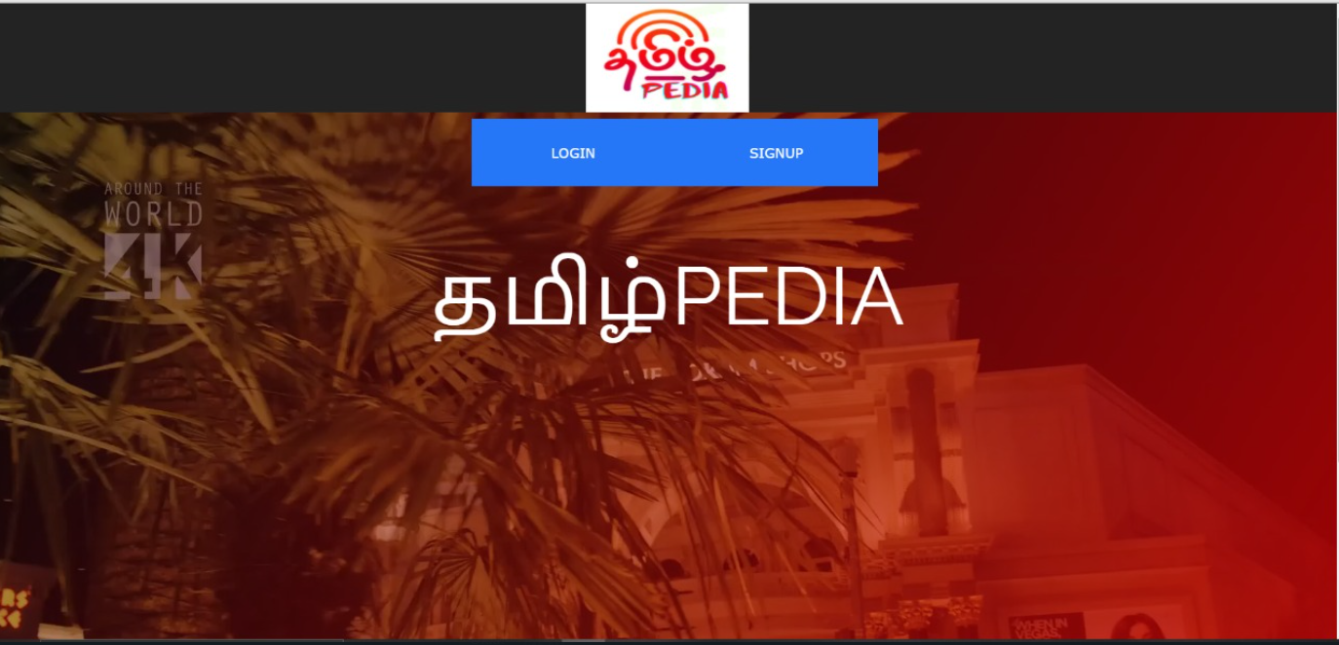
LIVE WORKING SESSION
Here’s the link to our video presentation: https://drive.google.com/file/d/1c_xt2hIJotn2AinkkXIwnYa2kXFvx3zu/view?usp=sharing
Link to our GITHUB Repo:
https://github.com/venkatr21/tamilPEDIA

Slide 8
PROS & CONS OF PROPOSED MODEL:
PROS :
The model performs efficient keyword matching even inside the pdf or the resource, information retrieval and faster search powered by PHP Backend and azure cloud services.
Only the ethical threats are kept on and the other least voted ones are ignored or removed by time.
It uses Microsoft language translation API for swift content in Tamil
CONS:
Initially the amount of resources are at the bare minimum until there’s a huge number of signups
Managing Databases would really be a tedious task

Slide 9
REFERENCES:
https://www.w3schools.com/php/DEFAULT.asp
https://tamilelibrary.org/teli/chrono1.html
https://www.livehistoryindia.com/history-daily/2019/10/09/tamil-literatures-enduring-classics
https://azure.microsoft.com/en-in/services/cognitive-services/translator/

